Slide 1





Topic :- Sets

Slide 2

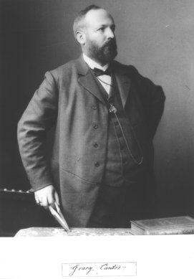
History of SETS
The theory of sets was developed by German mathematician Georg Cantor (1845-1918). He first encountered sets while working on “problems on trigonometric series”

Slide 3


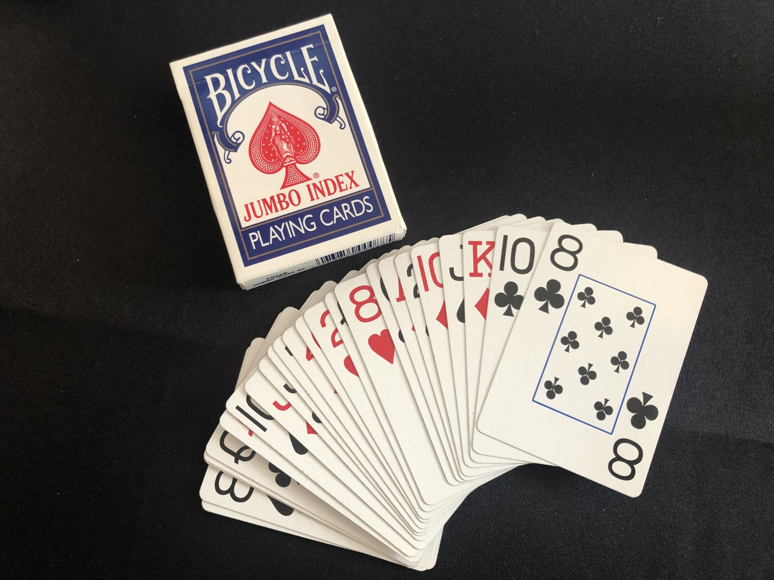
Introduction to SETS
A set is the mathematical model for a collection of different things.
A set contains elements or members, which can be mathematical objects of any kind: numbers, symbols, points in space, lines, other geometrical shapes, variables, or even other sets.

Slide 4
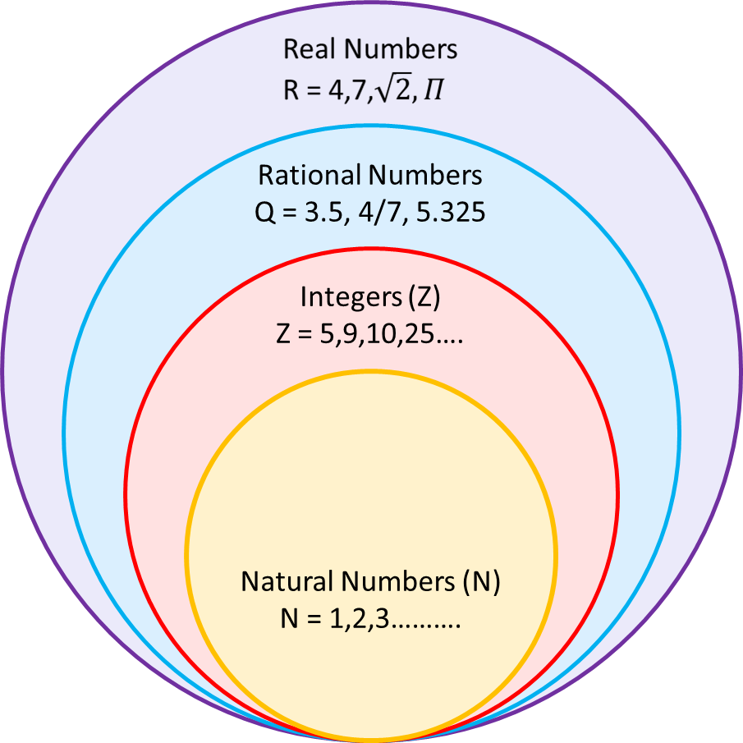
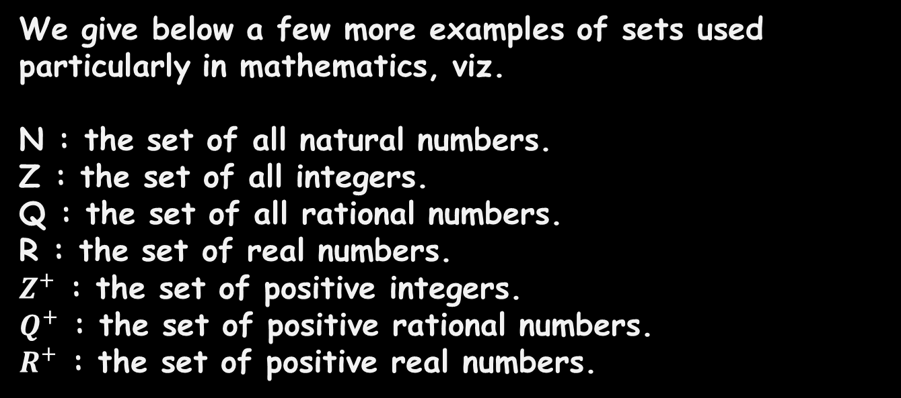
Example of SETS in MATHS
We give below a few more examples of sets used particularly in mathematics, viz.
N : the set of all natural numbers.
Z : the set of all integers.
Q : the set of all rational numbers.
R : the set of real numbers.
$Z^{+}$ : the set of positive integers.
$Q^{+}$ : the set of positive rational numbers.
$R^{+}$ : the set of positive real numbers.

Slide 5
Types of SETS
Empty Sets.
Equal Sets.
Finite Sets.
Subsets.
Infinite Sets.
Universal Set.

Slide 6
Types of SETS
Empty Sets:-
- A set which does not contain any element is called
the empty set or the null set or the void set.
- The empty set is always considered as subset of any
set.
- set {0} is not empty set it contains element zero.
{ }
Empty set is denoted as { }

Slide 7
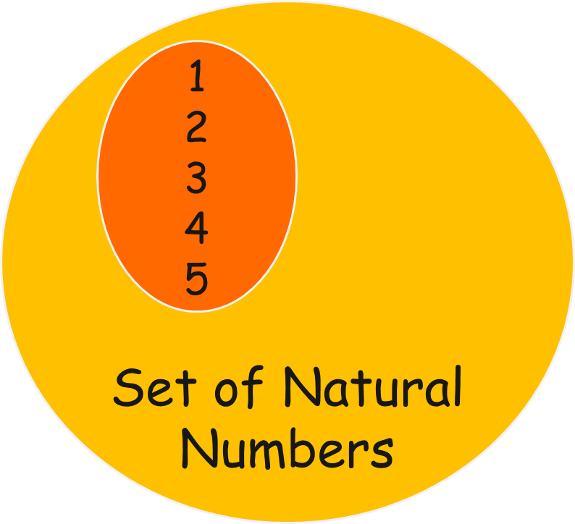
Types of SETS
Finite Sets:-
- If a set contain no element or fixed number of
elements is called the finite set.
- Example:- A : {Set of months in a year}
B : {1,2,3,4,5}
C : {Set of prime numbers less than 10}
Infinite Sets:-
- If a set contain endless number of element is
called the infinite set.
- Example:- A : {Set of Natural numbers}
B : {1,3,5,7,9,. . . . }

Slide 8
Types of SETS
Equal Sets:-
- Given two sets A and B, if every element of A is also an element of B and if
every element of B is also an element of A, then the sets A and B are said to be
equal.
- Example:- Let A = {1,2,3,4} and
B = {3,4,2,1}
here set A = set B it is an equal set.
Set A
Set B
1
2
3
4
2
4
1
3
Equal
Set

Slide 9
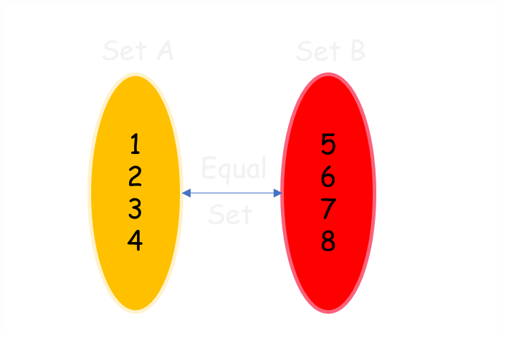
Types of SETS
Universal Set:-
- Universal Set is a set which contains all the elements of the other
sets.
- Example:- Let A = {1,2,3,4} and B = {5,6,7,8}
so the Universal set will have all the elements of
set A and B.
U = {1,2,3,4,5,6,7,8}
Universal set is denoted as ‘U’

Slide 10
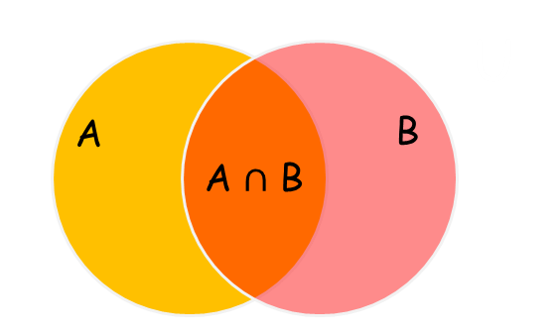
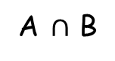
Venn Diagram
- Venn diagram is used to represent all possible relation of different sets.
- It can be represented by any closed figure, circle ,polygon ,hexagon or square.
But usually, we use circles to represent.
A
Z
A $∩$ B
Y
B
X

Slide 11
SET Operations
- Set operators are the operators that are applied on two or more sets to develop a relationship between them.
- There are 4 main kinds of Set operators which are:-
Union of Sets
Intersection of Sets
Complement of Sets
Difference between Sets

Slide 12
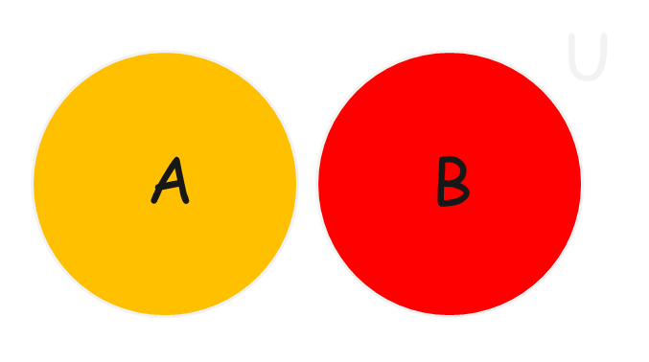
Set Operators
Union of Sets:-
- The union of sets A and B is the set of items that are in A or B
Notation:- A U B
Examples:-
{1,2} U {1,2,3} = {1,2,3}
{1,2,3} U {4,5,6} = {1,2,3,4,5,6}
{A,B,C} U {X,Y,Z} = {A,B,C,X,Y,Z}

Slide 13
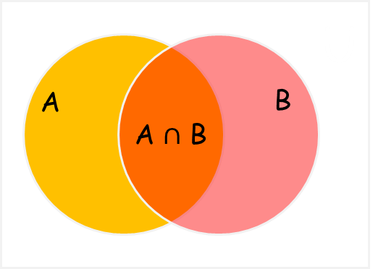

Set Operators
Intersection of Sets:-
- The intersection of sets A and B is the set of items that are common in A and B.
Notation:- A $∩$ B
Examples:-
{1,2} $∩$ {1,2,3} = {1,2}
{1,2,3} $∩$ {4,5,6} = { }
{A,B} $∩$ {A,B} = {A,B}

Slide 14
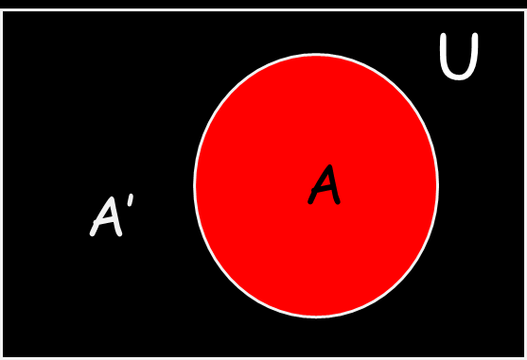

Set Operators
Complement of Sets:-
- The complement of set A is the set of items that are in the universal set
U but are not in A.
Notation:- A’ or $A^{c}$
Examples:-
{1,2} $−$ {1,2,3} = {3}
{1,2,3} - {4,5,6} = {1,2,3}
{A,B} - {A,B} = { }

Slide 15
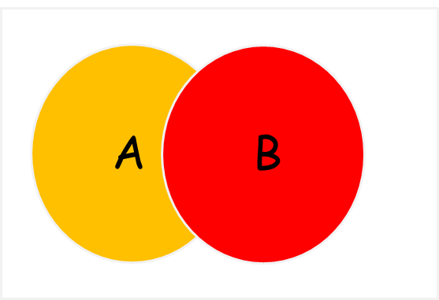

Set Operators
Difference between Sets:-
- The difference of sets A and B is the set of items that are in A but
not in B.
Notation:- A $−$ B
Examples:-
{1,2} $−$ {1,2,3} = {3}
{1,2,3} - {4,5,6} = {1,2,3}
{A,B} - {A,B} = { }

Slide 16
Properties of sets
Idempotency :- A ∩ A = A = A ∪ A
Commutativity :- A ∩ B = B ∩ , also A ∪ B = B ∪ A
Associativity :- A ∩ (B ∩ C) = (A ∩ B) ∩ C and A ∪ (B ∪ C) = (A ∪ B) ∪ C
Distributivity :- A ∩ (B ∪ C) = (A ∩ B) ∪ (A ∩ C) and A ∪ (BC) = (A ∪ B) ∩ (A ∪ C)
Absorption :- A ∩ (A ∪ B) = A and A ∪ A ∩ B = A
Double complementation :- −−A = A
De Morgan’s laws :- −(A ∩ B) = −A ∪ −B and −(A ∪ B) = −A ∩ −B

Slide 17
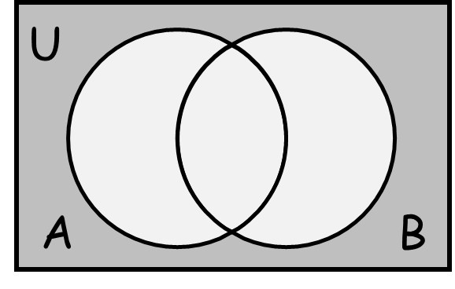
De Morgan’s First Law
- It states that the complement of the union of any two sets is equal to
the intersection of the complement of that sets.
- This De Morgan’s theorem gives the relation of the union of two sets with
their intersection of sets by using the set complement operation.
- the mathematical relation of De Morgan’s first
law is given by (A U B)′=A′ ∩ B′

Slide 18
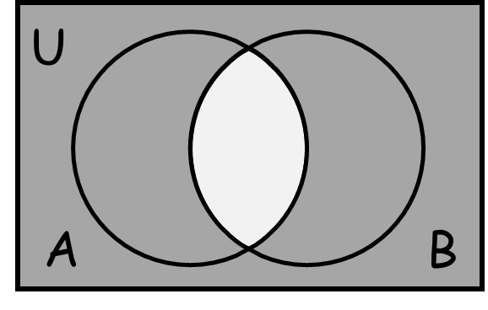
De Morgan’s Second Law
- It states that the complement of the intersection of any two sets is
equal to the union of the complement of that sets.
- This type of De Morgan’s law gives the relation of the intersection of two
sets with their union of sets by using the set complement operation..
- the mathematical relation of De Morgan’s second
law is given by (A ∩ B)′=A′∪ B′

Slide 19
Application of SETS
In the world of computer science and, particularly, database management systems, SQL or Structured Query Language is a widely used standard language for managing relational databases.
One of the essential components of SQL is the SET clause, which plays a crucial role in data manipulation tasks.
The SQL SET clause is primarily used to modify the value of one or more columns in a database table. It is paired with the UPDATE statement to modify existing records in a table.

Slide 20


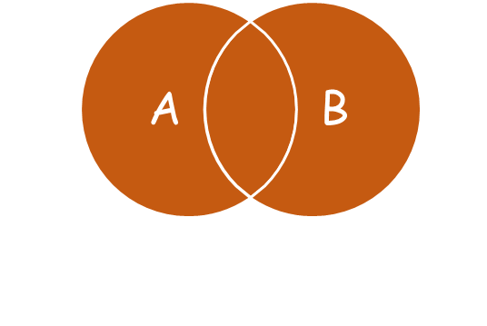
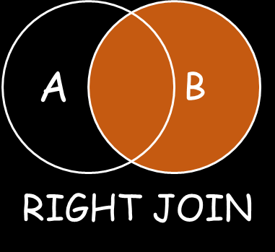

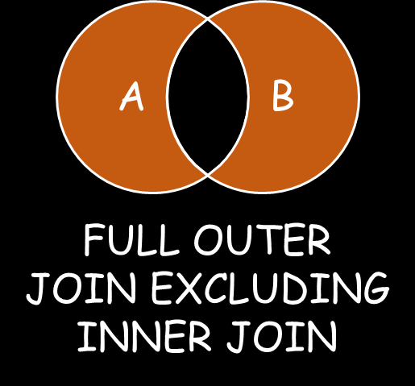

Application of SETS

Slide 21
THANK YOU !!

